Slide 1
Simple Scheduler Requirements
Jason Santana, Matthew Pinneo, Matthew Spitzley

Slide 2
Abstract
Simple Scheduler is an Android app for time management. Users can schedule and manage their plans quickly and easily, and never miss a due date with customizable reminders. Users can choose to synchronize their data by signing in with Google.

Slide 3
Tools and Technologies
Android Studio
Android
Java
MySQL
PHP
Visual Studio Code

Slide 4
Task List Screen
List of Created Tasks
Displays time, name and date of each task.
Selecting task will allow for editing or marking as complete.
Sorted by date then alphabetically.
Categories
Opens a listbox of categories, allowing the user to only see tasks of specific categories.
An edit button will bring the user to a new screen called the Edit Category screen.
Settings
Opens settings menu in new screen.
Add New Task
Takes user to new screen for creating tasks.
Late Tasks
User will receive notification that task is late. Task will be highlighted.

Slide 5
Edit Category Screen
Shows all of the existing categories, by choosing a category the user will have the ability to:
Select “edit” which will allow the user to change the name of the category.
Select “delete” which will delete that category.
Deleting a category will change any tasks of that category to “No Category”
Selecting new category will allow the user to create a new category.
This lets the user name the new category then it is added to the list of categories.

Slide 6
New Task Screen
The user can make a new task which contains:
The name of the task (required).
What category the task falls under (optional).
The date to be completed (optional).
The time of day to be completed (optional).
When the task should reoccur (optional).
Whether or not to get email notifications.
Whether or not to get push notifications.

Slide 7
Calendar Screen
Displays calendar for current month.
Days with tasks will display the name of each task.
Selecting an empty day will direct user to the new task screen with the day portion auto-filled.
Selecting a day with tasks scheduled will display a screen with a list of all tasks for that day.
This screen will also display an option to add a new task that will direct user to the new task screen.
A yearly view option.
Days with tasks will be highlighted but not show specific tasks.
Each month can be selected to view the more detailed task lists.

Slide 8
History Screen
Accessed by swiping left on main screen.
Shows completed or cancelled tasks.
Sorted by date then alphabetically.
Selecting a task will show options for restoring or deletion.
Restoring will remove from history list and add to active tasks as incomplete.
Deletion will remove task permanently.
There will be a “Select All” option to select all tasks in the history list.
You will be able to restore or delete all tasks in list.
An option to allow user to select multiple, specific tasks.
You will have the same option to restore or delete selected tasks.

Slide 9
Settings Screen
Accessible from History, Task List, and Calendar screens.
Will contain:
Help button to display a description of Simple Scheduler features.
An option to toggle between 12hr/24hr time format.
The ability to change date formats (mm/dd/yyyy vs dd/mm/yyyy).
There will be six total date formats.
An option to make the start up screen the Task List screen or Calendar screen.
An option to set default time for notification to occur.
An option to turn off push notifications.
An option to sign in with a Google account. If signed in:
An option to synchronize tasks to database.
An option to enable/disable email notifications.

Slide 10
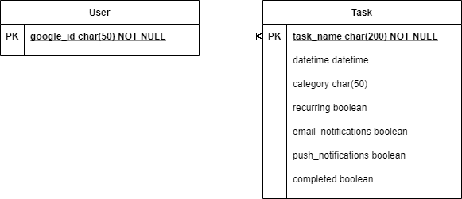
Database
If signed in with Google, users can enable synchronization.
Otherwise the data is stored locally.

Slide 11
Challenges
Mobile development and testing
Database management

